Slide 1
Ethics in Business
3
Better Business
4th Edition
Solomon · Poatsy · Martin
chapter
© 2016 Pearson Education, Inc.

Slide 2
Learning Objectives
What are ethics and different ethical systems?
How does someone create a personal code of ethics?
How might personal ethics play a role in the workplace?
How can you evaluate a company’s ethical code using available resources, such as a mission statement?
How do a company’s policies and decisions affect its achievement of corporate social responsibility (CSR)?
What challenges does a company face in balancing the demands of social responsibility with successful business practices?
What is legal compliance, and how does it affect ethical conduct?
What strategies can a company use to recover from ethical lapses?
How can companies apply ethical standards to create new business opportunities?
What approaches can a company use to develop and maintain an ethical environment?
Notes:
In this chapter, we will study:
Ethics and different ethical systems
Personal codes of ethics and the role of personal ethics in the workplace
Understanding and evaluating companies’ ethical codes and corporate social responsibility
Balancing the demands of social responsibility with successful business practices
Legal compliance and ethical conduct
How companies recover from ethical lapses
Ethical standards and new business opportunities
Developing and maintaining an ethical environment

Slide 3
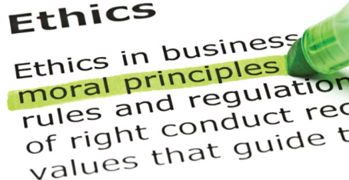
Ethics
What are ethics?
Ethical systems
Moral relativism
Situational ethics
Judeo-Christian ethics
What is unethical behavior?
What is amoral behavior?
Notes:
Learning Objective 1: What are ethics and different ethical systems?
Ethics refers to the study of the general nature of morals and of the specific moral choices a person makes.
Not all people share the same ethics. Some systems of ethical conduct are based on religious systems, some are cultural or national, and some have been passed from generation to generation within a specific ethnic group.
Ethics can be hard to define. There are many different ethical systems that one can use to evaluation a situation or decision:
Moral relativism holds that there is no universal moral truth but only people’s individual beliefs, perspectives, and values. Each person, therefore, has his or her own ideas of right and wrong.
Situational ethics is based on the idea that people make decisions based on a specific situation instead of universal laws.
Judeo-Christian ethics refers to the common set of basic values shared across both Jewish and Christian religious traditions. These include respecting property and relationships, respecting one’s parents, and being kind to others.
Unethical behavior does not conform to a set of approved standards of social or professional behavior.
Amoral behavior is when a person has no sense of right and wrong and no interest in the moral consequences of his or her actions.

Slide 4
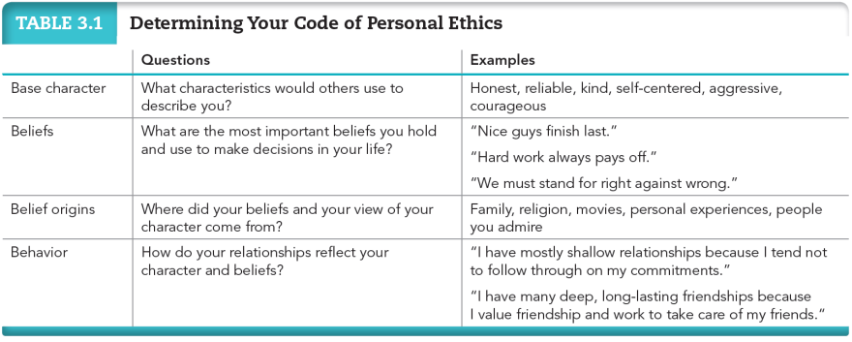
Determining Your Code of Personal Ethics
3-4
Notes:
Learning Objective 2: How does a person create a personal code of ethics?
Personal ethics are a set of principles that guide the decisions you make in your life. Life experiences offer all of us opportunities to develop our personal ethics.
Table 3.1 in the text outlines one way to analyze your own ethical system. Write down your answers as you go through the four steps:
What characteristics would others use to describe you?
What are the most important beliefs you hold and use to make decisions in your life?
Where did your beliefs and your views of your character come from?
How do your relationships reflect your character and beliefs?
Businesses follow a similar plan when creating their own statements of values. It will be easier for you to work for a business if you have a well-defined statement of personal values.

Slide 5
Personal Ethics in a Business Environment
What if you are asked to act against your ethics?
What if you unknowingly do something “wrong”?
What if you knowingly do something unethical or even illegal?
© 2016 Pearson Education, Inc.
Notes:
Learning Objective 3: How might personal ethics play a role in the workplace?
How do personal ethics carry into the work environment?
What if you are asked to act against your ethics?
What if you unknowingly do something “wrong”?
What if you knowingly do something unethical or even illegal?

Slide 6
Pricing Fixing
Price fixing—illegal practice when a group of companies agree to set a product’s price
Mark Whitacre, a senior executive with the agricultural giant Archer Daniels Midland (ADM), blew the whistle on ADM’s multinational price-fixing scheme.
Notes:
Price fixing occurs when a group of companies agree among themselves to set a product’s price, independent of market demand or supply.
Mark Whitacre, a senior executive with agricultural giant Archer Daniels Midland, or ADM, was involved for years in a multinational price-fixing scheme. Based on such price fixing, ADM stole millions of dollars from its customers by agreeing with its competitors to set a product’s price.
Whitacre was a participant in all illegal activities and was set to rise to the very top of the organization. His wife, however, became increasingly conflicted with what was happening at ADM and with her own ethical values. She finally threatened to divorce Whitacre unless he found a way to end his involvement.
Whitacre then went to the FBI and agreed to tape meetings at ADM, ultimately recording more than 250 hours of incriminating audio and videotape.
Although some people decide they will be flexible with their own ethical standards at the workplace, it can often take a toll on their mental state, their relationships, and their physical health.

Slide 7
Identifying a Company’s Ethics
How can you examine a company’s ethics?
Companies document their philosophies, often through:
Code of ethics—a statement of the company’s commitment to ethical practices
Mission statement—defines the core purpose of an organization
Notes:
Learning Objective 4: How can you evaluate a company’s ethical code using available resources, such as a mission statement?
A code of ethics is a written statement of a company’s commitment to certain ethical practices.
A mission statement defines the core purpose of the organization—why it exists—and often describes its values, goals, and aspirations.

Slide 8
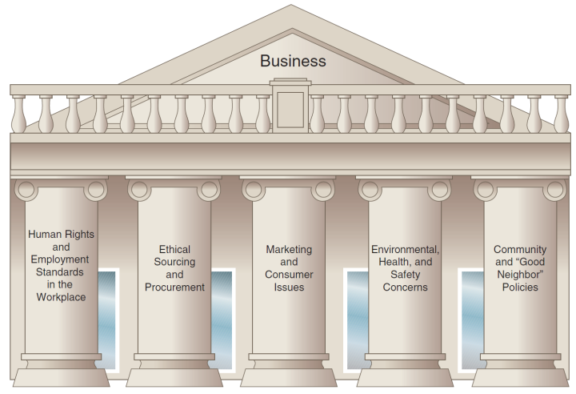
Corporate Social Responsibility (CSR)
Notes:
Learning Objective 5: How do a company’s policies and decisions affect its achievement of corporate social responsibility?
Corporate social responsibility, or CSR, is a company’s obligation to conduct its activities with the aim of achieving social, environmental, and economic development. It is the collection of policies covering the following five major areas:
Human rights and employment standards in the workplace
Ethical sourcing and procurement
Marketing and consumer issues
Environmental, health, and safety concerns
Community and “good neighbor” policies

Slide 9
Can a Company Really Be Socially Responsible?
Economist Milton Friedman said, “Asking a corporation to be socially responsible makes no more sense than asking a building to be.”
Conflicts of CSR:
Difficult to measure how CSR interacts with a long-term responsibility to the community or planet
Difficult to balance profits for shareholders and quality for consumers
Notes:
Milton Friedman and others have argued that there is no place for social responsibility as a business function. The business’ sole responsibility is to make a profit and by doing so, the company will be providing products, jobs, and strong stockholder value, and therefore will be socially responsible to these groups of consumers, employees, and stockholders.
The role of a company is to maximize profits to stockholders. However, it can be difficult to balance this with the company’s obligation to the community and planet.
Additionally, companies must weigh larger profits for shareholders against potential decreases in quality for consumers.

Slide 10
Benefits of CSR
A positive reputation in the marketplace
Strong recruitment and talent retention
Efficiency increases when companies use materials efficiently and minimize waste
Increased sales via product innovations and environmentally and ethically conscious labeling
Notes:
The benefits of CSR include:
The company develops a positive reputation in the marketplace with consumers as well as with its suppliers and vendors.
The company enjoys strong recruitment and retention of talent.
Efficiency increases when companies use materials efficiently and minimize waste.
Sales increase through new product innovations and environmentally and ethically conscious labeling.

Slide 11
Measuring CSR
Is it possible to measure a company’s CSR level?
Social audits
Ratings and rankings
Boston College Center for Corporate Citizenship
Calvert Investment Company
Fortune’s 10 Most-Admired
Companies
Self-reporting
Corporate philanthropy
Notes:
A social audit reports how well a company is meeting its social responsibilities and is usually conducted by a third party.
The Calvert Investment Company assigns companies scores based on environment, workplace, business practices, human rights, and community relations. Investors can use the “Know What You Own®” tool to investigate a fund and check the environmental and social performance of the companies in the fund.
In addition to social audits and the Calvert ratings, a number of magazines, such as Fortune, publish lists of admired companies each year.
Many companies participate in corporate philanthropy, donating some of their profits or resources to charitable organizations. The Bill and Melinda Gates Foundation (picture) has addressed issues of global infant survival rates, a vaccine for malaria, and public access to technology through a $40 billion endowment.

Slide 12
The Challenges of CSR
Balancing the demands of social responsibility with successful business practices
Conflicting demands pose numerous ethical challenges such as:
Making life-saving drugs available to the world’s poor
Conducting a profitable business in an environmentally sound manner
Notes:
Learning Objective 6: What challenges does a company face in balancing the demands of social responsibility with successful business practices?
Consider the dilemma facing companies that produce very unique products, such as pharmaceutical companies that develop medications to treat AIDS. What is their moral and ethical obligation with regard to the AIDS pandemic in sub-Saharan Africa?
Intel has been able to generate substantial profits while reducing emissions and providing a broad range of benefits to employees, including covering same-sex partners.

Slide 13
The Effects of CSR on Society
Environmental
- Local and global impact
Economic
- Product availability, price, and quality
- Business sustainability
Employee morale
- Advancement
- Work environment
- Values
Notes:
Environmentally, how businesses operate has both local and global effects.
Economically, if a company behaves in an irresponsible way, it can have negative effects on consumers and stakeholders alike.
For employees’ morale, the potential for advancement, the day-to-day work environment, and the overall sense of purpose and value are affected by the degree to which the company practices sound CSR. The ethical culture of a company and its leadership have an effect on its workers every day.
It is important that individuals find a company with a CSR philosophy that matches their ideas. Employees will have higher morale with such a match.
Information about a company’s CSR policy can be found on its Web site, in company literature, in conversations during interviews, and even on personality tests conducted during the interview process, when the company is determining whether the candidate’s personality matches the company’s.

Slide 14
Can You Affect How Businesses Operate Ethically?
You can affect:
- Your own ethical behavior
- Who you do business with
- Who you invest in
- Who you work for
Notes:
Can you affect how businesses operate ethically? Yes, you can.
In addition to contributing by means of your own personal conduct, your choices about where and on what to spend your money greatly influence corporate behavior. Companies survive only because consumers buy their products or use their services. If you don’t believe in a company’s ethics, you can take your business elsewhere.
Socially responsible investing is investing only in companies that have met a certain standard of corporate social responsibility.
By agreeing to work for a company, you’re saying that you agree with its mission and ethics.

Slide 15
Legal Regulations and Compliance
Laws are created to govern the products or processes of a specific industry.
Example: Consumer Bill of Rights (1962)
Right to safety
Right to choose
Right to information
Right to be heard
Legal compliance—conducting a business within the boundaries of all the legal regulations of that industry
Notes:
Learning Objective 7: What is legal compliance, and how does it affect ethical conduct?
When enough people feel that a particular ethical standard is important, it eventually becomes law. These laws may relate to a particular product or industry. For example, the USDA has created stringent guidelines about what can be labeled as organic.
Legal compliance refers to conducting a business within the boundaries of all the legal regulations of that industry.
Government agencies such as the Equal Employment Opportunity Commission and the Securities and Exchange Commission provide guidance to companies to help them maintain legal compliance.

Slide 16
Violating Ethics and the Law: The Example of Enron
Enron was the seventh largest U.S. company at its zenith.
It had a written code of ethics including social and environmental values.
In 2001, fraudulent finance practices surfaced and the company went bankrupt.
- Key officers were found guilty of fraud and other charges.
- Arthur Andersen, Enron’s accounting firm, was convicted of obstruction of justice and the firm closed.
Sarbanes/Oxley Act passed in 2002, with strict corporate finance requirements and penalties.
Notes:
At one time, Enron employed 21,000 people in more than 40 countries and was in the top 25 of Fortune’s 100 Best Companies To Work For.
Enron’s published value statements included respect, integrity, and excellence. However, by October 2001, it became evident that the company had hid debts totaling more than $1 billion to inflate its stock price and had manipulated the Texas and California power markets. It had also bribed foreign governments to win contracts abroad.
Enron went into bankruptcy, founder Kenneth Lay was convicted on 10 counts of fraud and conspiracy, and CEO Jeffrey Skilling was convicted of 18 counts of fraud. Other company officers were charged too.
Enron’s auditing firm, Arthur Andersen, was convicted of obstruction of justice for destroying documents relating to Enron’s fraud.
To avoid future occurrences such as these, the Sarbanes/Oxley Act was created. Under this act, CEOs are required to verify their companies’ financial statements and vouch for their accuracy with the Securities and Exchange Commission.

Slide 17
Recovering from Weak Ethical Conduct
Whistle-blowers:
Jeffery Wigand
Sergeant Joseph Darby
Common strategies to recover
Find a leader
Empower all employees
Redesign internal rewards
Notes:
Learning Objective 8: What strategies can a company use to recover from ethical lapses?
A whistle-blower is an employee who reports misconduct, most often to an authority outside the firm. Famous examples from the text include:
Jeffrey Wigand, a vice president of a tobacco company, who revealed on 60 Minutes in 1996 that his company was deliberately manipulating the effect of nicotine in its cigarettes to promote addiction.
Sergeant Joseph Darby, who sent an anonymous note and a set of images to the U.S. Army Criminal Investigation Command of the abuse taking place at Abu Ghraib prison in Iraq.
Companies that are attempting to recover from scandal often follow some common strategies:
They find a leader who will set an example of the new ethical image of the company.
They restructure their internal operation to empower all employees to consider ethical implications of decisions and to feel free to speak up when they spot a concern.
They redesign internal rewards—for example, restructuring the incentive package for a sales department so that there is a financial reward for building an ongoing relationship with a client rather than just closing a sale.

Slide 18
Creating New Markets with an Ethical Focus
New markets with an ethical focus:
- Offering clean fuel
- Creating medical vaccines
- Fighting censorship
- Going green
What other examples can you think of?
Notes:
Learning Objective 9: How can companies apply ethical standards to create new business opportunities?
Some companies focus on creating new markets with an ethical focus. Others redesign their business so that they no longer have a negative impact on the environment. Still others use ethical challenges as a tool to unite and empower employees.
Many firms have created opportunities with new types of products and services, such as:
Clean fuel
Medical vaccines (such as malaria)
Fighting censorship
Going green
Sustainability is the process of working to improve the quality of life in ways that simultaneously protect and enhance the Earth’s life support systems.

Slide 19
Ethical Focus from the Start
Steps to make sure employees get off to an ethical start:
Code of ethics
Mission statement
Orientation programs
Notes:
Learning Objective 10: What approaches can a company use to develop and maintain an ethical environment?
There are a number of steps businesses can take to make sure employees get off to an ethical start:
Managers can design a strict code of ethics that defines acceptable and unacceptable behavior.
Managers can make sure a mission statement is in place and is communicated throughout the business.
The company can offer orientation programs to new employees to inform them of the ethical standards in place and the conduct expected of them.

Slide 20
Ethical Focus Every Day
Communicate regularly about acceptable behavior.
Check to make sure that the code of ethics is being followed.
Create a hotline for anonymous reports.
Employ ongoing ethics training.
Notes:
How can a company maintain their ethical focus:
Communicate regularly about acceptable and unacceptable business practices.
Develop a strict code of ethics and check to make sure the code is being followed.
Create a hotline for employees to anonymously report violations of the ethics code and make sure the allegations are followed up on.
Show how serious the company is about ethics and employ ongoing training. Ethics training programs are designed to boost the awareness of their employees about ethical issues. Training occurs throughout all levels of the organization.
Developing an ethical environment often requires a concentrated investment of time and resources; however, it remains a priority for most businesses.

Slide 21
Chapter Summary
What are ethics and different ethical systems?
How does a person create a personal code of ethics?
How might personal ethics play a role in the workplace?
How can you evaluate a company’s ethical code using available resources such as a mission statement?
How do a company’s policies and decisions affect its achievement of corporate social responsibility?
What challenges does a company face in balancing the demands of social responsibility with successful business practices?
What is legal compliance, and how does it affect ethical conduct?
What strategies can a company use to recover from ethical lapses?
How can companies apply ethical standards to create new business opportunities?
What approaches can a company use to develop and maintain an ethical environment?
Notes:
Chapter Summary
What are ethics and different ethical systems? Ethics are the moral choices people make. Ethical systems include moral relativism, situational ethics, and Judeo-Christian ethics, among others.
How does a person create a personal code of ethics? You can create a personal code of ethics by determining your base character, beliefs that influence your decision-making, how your behavior matches your beliefs, and why you hold these beliefs.
How might personal ethics play a role in the workplace? Companies have expectations for how you conduct yourself inside and outside the office. Conflicts occur when personal ethics differ from the company’s.
4. How can you evaluate a company’s ethical code using available resources such as a mission statement? Some companies may have a written code of ethics or a public mission statement.
How do a company’s policies and decisions affect its achievement of corporate social responsibility? A strong CSR plan allows a company to serve communities well. It also benefits the corporation in direct and indirect ways.
6. What challenges does a company face in balancing the demands of social responsibility with successful business practices? Companies must balance their obligations to consumers and investors as well as employees and the community.
What is legal compliance, and how does it affect ethical conduct? Legal compliance refers to conducting a business within the boundaries of all the legal regulations of that industry. Companies that establish and adhere to high ethical standards are more likely to maintain legal compliance.
What strategies can a company use to recover from ethical lapses? The company can work to find a leader who will set an example of the new ethical image of the company, restructure its internal operation to empower all employees to consider ethical implications of decisions and to feel free to speak up when they have concerns, and redesign internal rewards.
9. How can companies apply ethical standards to create new business opportunities? Whereas some businesses are tackling ethical issues and offering consumers more ethical choices through their businesses, others are attempting to reduce the impact they have on the environment.
10. What approaches can a company use to develop and maintain an ethical environment? Managers can make sure a mission statement is in place and is communicated throughout the business. Companies can offer orientation programs to new employees to inform them of the ethical standards in place. Ethics training programs can boost the awareness of employees about ethical issues.

